Slide 1

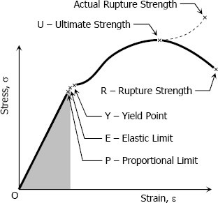
Strain Simple Strain
Strain is the ratio of the change in length caused by the applied force, to the original length, it is also known as unit deformation,
Strain is calculated by :
where ε is the strain , δ is the deformation and L is the original length, thus ε is dimensionless.
Stress-Strain Diagram
Suppose that a metal specimen be placed in tension-compression testing machine. As the axial load is gradually increased in increments, the total elongation over the gage length is measured at each increment of the load and
this is continued until failure of the specimen takes place. Knowing the original cross-sectional area and length of the specimen, the normal stress ζ and the strain ε can be obtained. The graph of these quantities with the stress
ζ along the y-axis and the strain ε along the x-axis is called the stress-strain diagram. The stress-strain diagram differs in form for various materials.
The diagram shown above is that for a medium carbon structural steel. Metallic engineering materials are classified as either ductile or brittle

Slide 2

materials. A ductile material is one having relatively large tensile strains up to the point of rupture like structural steel and aluminum, whereas brittle materials has a relatively small strain up to the point of rupture like cast iron and concrete. An arbitrary strain of 0.05 mm/mm is frequently taken as the dividing line between these two classes.
Proportional limit
From the origin O to the point called proportional limit, the stress-strain curve is a straight line. This linear relation between elongation and the axial force causing was first noticed by Sir Robert Hooke in 1678 and is called Hooke's Law that within the proportional limit, the stress is directly proportional to strain or
The constant of proportionality k is called the Modulus of Elasticity E or Young's Modulus and is equal to the slope of the stress-strain diagram from O to P. Then
Elastic limit
The elastic limit is the limit beyond which the material will no longer go back
to its original shape when the load is removed, or it is the maximum stress that may e developed such that there is no permanent or residual deformation when
the load is entirely removed.
Elastic and plastic range
The region in stress-strain diagram from O to P is called the elastic range. The
region from P to R is called the plastic range.
Yield point
Yield point is the point at which the material will have an appreciable
elongation or yielding without any increase in load.
Ultimate strength
The maximum ordinate in the stress-strain diagram is the ultimate strength or
tensile strength.

Slide 3
Rapture strength
Rapture strength is the strength of the material at rupture. This is also known
as the breaking strength.
Axial deformation
In the linear portion of the stress-strain diagram, the tress is proportional to
strain and is given by
ζ=Eε
since (ζ = P / A) and (ε = δ / L), then P / A = E δ / L. Solving for δ,
To use this formula, the load must be axial, the bar must have a uniform cross- sectional area, and the stress must not exceed the proportional limit. If however, the cross- sectional area is not uniform, the axial deformation can be determined by considering a differential length and applying integration.
If however, the cross-sectional area is not uniform, the axial deformation can be determined by considering a differential length and applying integration.

Slide 4
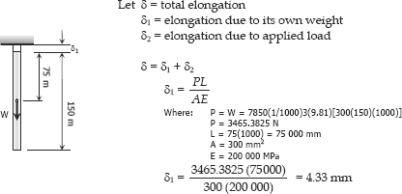
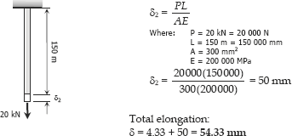
Examples:
Ex1: A steel rod having a cross-sectional area of 300 mm² and a length of 150 m is suspended vertically from one end. It supports a tensile load of 20 kN at
the lower end. If the unit mass of steel is 7850 kg/m³ and E = 200 × 10³ MN/m², find the total elongation of the rod.
Solution:

Slide 5

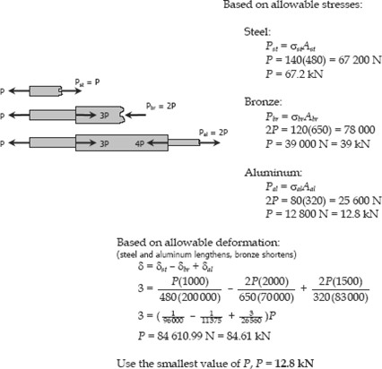
Ex2: A bronze bar is fastened between a steel bar and an aluminum bar as shown in Fig.
Axial loads are applied at the positions indicated. Find the largest value of P
that will not exceed an overall deformation of 3.0 mm, or the following stresses: 140 MPa in the steel, 120 MPa in the bronze, and 80 MPa in the aluminum. Assume that the assembly is suitably braced to prevent buckling.
Use Est = 200 GPa, Eal = 70 GPa, and Ebr = 83 GPa.
Solution:

Slide 6
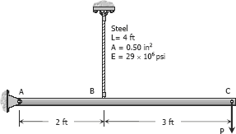
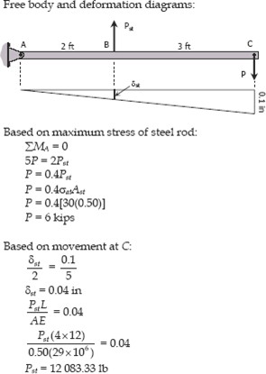
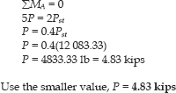
Ex3: The rigid bar ABC shown in Fig. below is hinged at A and supported by a steel rod at B. Determine the largest load P that can be applied at C if the stress in the steel rod is limited to 30 ksi and the vertical movement of end C must not exceed 0.10 in.
Solution:

Slide 7
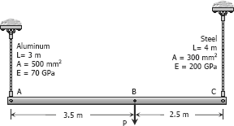
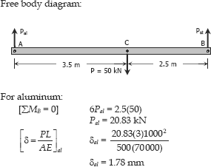
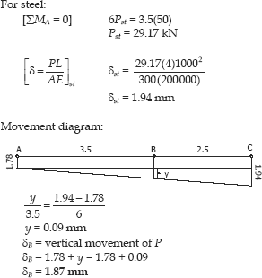
Ex.4: The rigid bar ABC, attached to two vertical rods as shown in Fig. below, is horizontal before the load P is applied. Determine the vertical movement of P if its magnitude is 50 kN.
Solution:

Slide 8
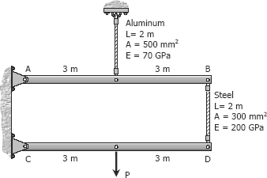
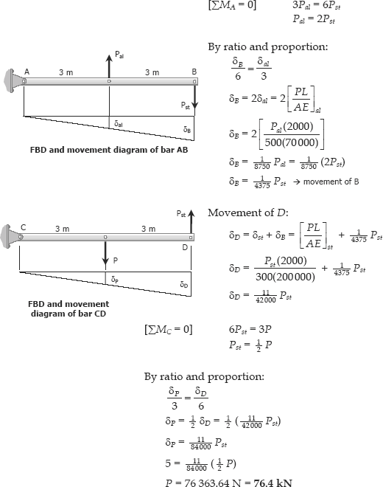
Ex.5: The rigid bars AB and CD shown in Fig. below are supported by pins at A and C and the two rods. Determine the maximum force P that can be applied as shown if its vertical movement is limited to 5 mm. Neglect the weights of all members.
Solution:

Slide 9


Shearing deformation
Shearing forces cause shearing deformation. An element subject to shear does not change in length but undergoes a change in shape.
The change in angle at the corner of an original rectangular element is called the shear strain and is expressed as
The ratio of the shear stress η and the shear strain γ is called the modulus of elasticity
in shear or modulus of rigidity and is denoted as G, in MPa.
The relationship between the shearing deformation and the applied shearing force is
where V is the shearing force acting over an area As.
Poisson' s ratio
When a bar is subjected to a tensile loading there is an increase in length of
the bar in the direction of the applied load, but there is also a decrease in a lateral dimension perpendicular to the load. The ratio of the sidewise deformation (or strain) to the longitudinal deformation (or strain) is called the Poisson's ratio and is denoted by ν. For most steel, it lies in the range of
0.25 to 0.3, and 0.20 for concrete.

Slide 10
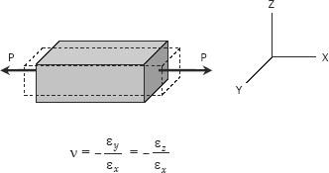
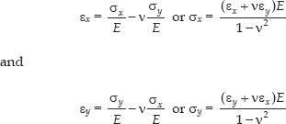
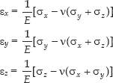
where ε_{x} is strain in the x-direction and ε_{y} and ε_{z} are the strains in the perpendicular direction. The negative sign indicates a decrease in the transverse dimension when εx is positive.
Biaxial deformation
If an element is subjected simultaneously by ensile stresses, ζx and ζy, in the x and y directions, the strain in the x-direction is ζx / E and the strain in the y direction is ζy / E. Simultaneously, the stress in the y direction will produce a lateral contraction on the x direction of the amount -ν εy or -ν ζy/E. The resulting strain in the x direction will be
Triaxial deformation
If an element is subjected simultaneously by three mutually perpendicular normal stresses ζx, ζy, and ζz, which are accompanied by
strains εx, εy, and εz, respectively,
Tensile stresses and elongation are taken as positive. Compressive
11

Slide 11

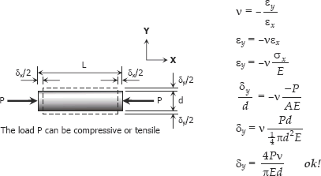
stresses and contraction are taken as negative.
Relationship Between E, G, and ν
The relationship between modulus of elasticity E, shear modulus G and Poisson's ratio ν
is:
Ex.1: A solid cylinder of diameter d carries an axial load P. Show that its change in diameter is 4Pν / πEd.
Solution:
Ex.2: A rectangular steel block is 3 inches long in the x direction, 2 inches long in the y direction, and 4 inches long in the z direction. The block is subjected to a triaxial loading of three uniformly distributed forces as follows: 48 kips tension in the x direction, 60 kips compression in the y direction, and 54 kips tension in the z direction. If ν = 0.30 and E = 29 × 10⁶ psi, determine the single uniformly distributed load in the x direction that would produce the same deformation in the y direction as the original loading.
11

Slide 12
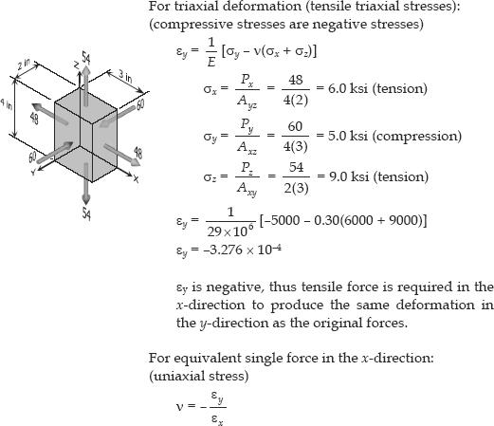
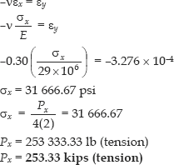
Solution:
12

Slide 13
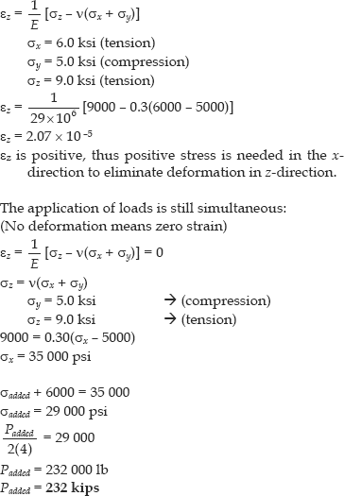
Ex.3:For the block loaded triaxially as described in next example, find the uniformly distributed load that must be added in the x direction to produce no deformation in the z direction .
Solution:
13

Slide 14
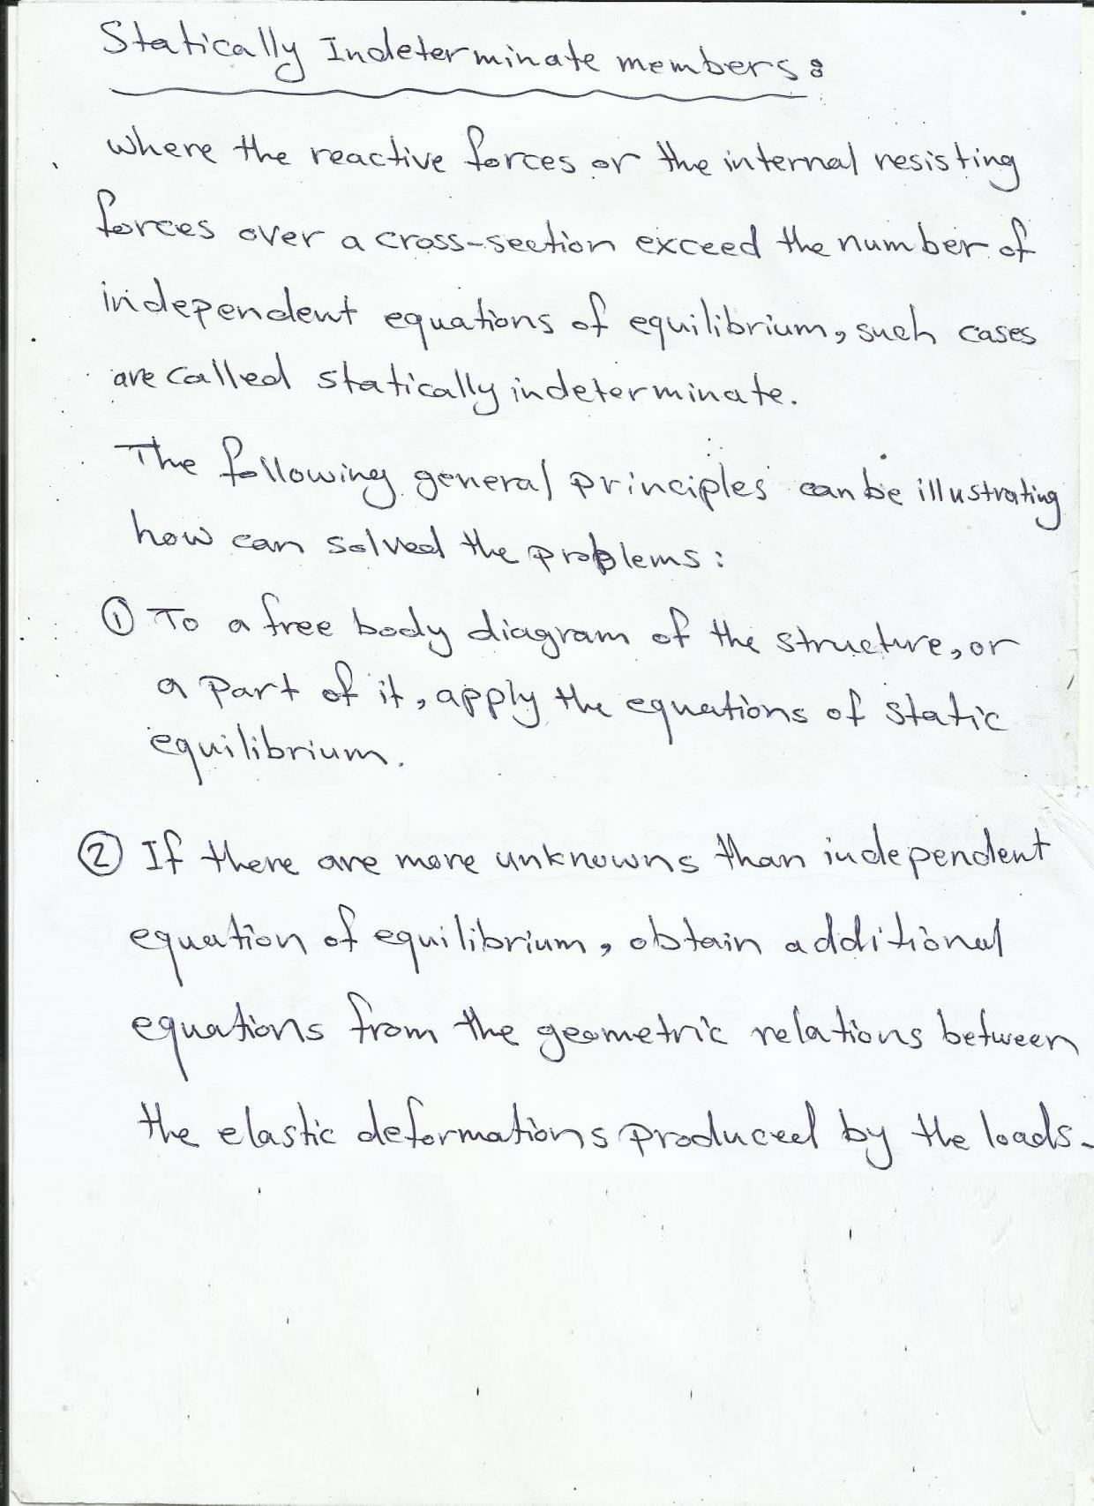

Slide 15
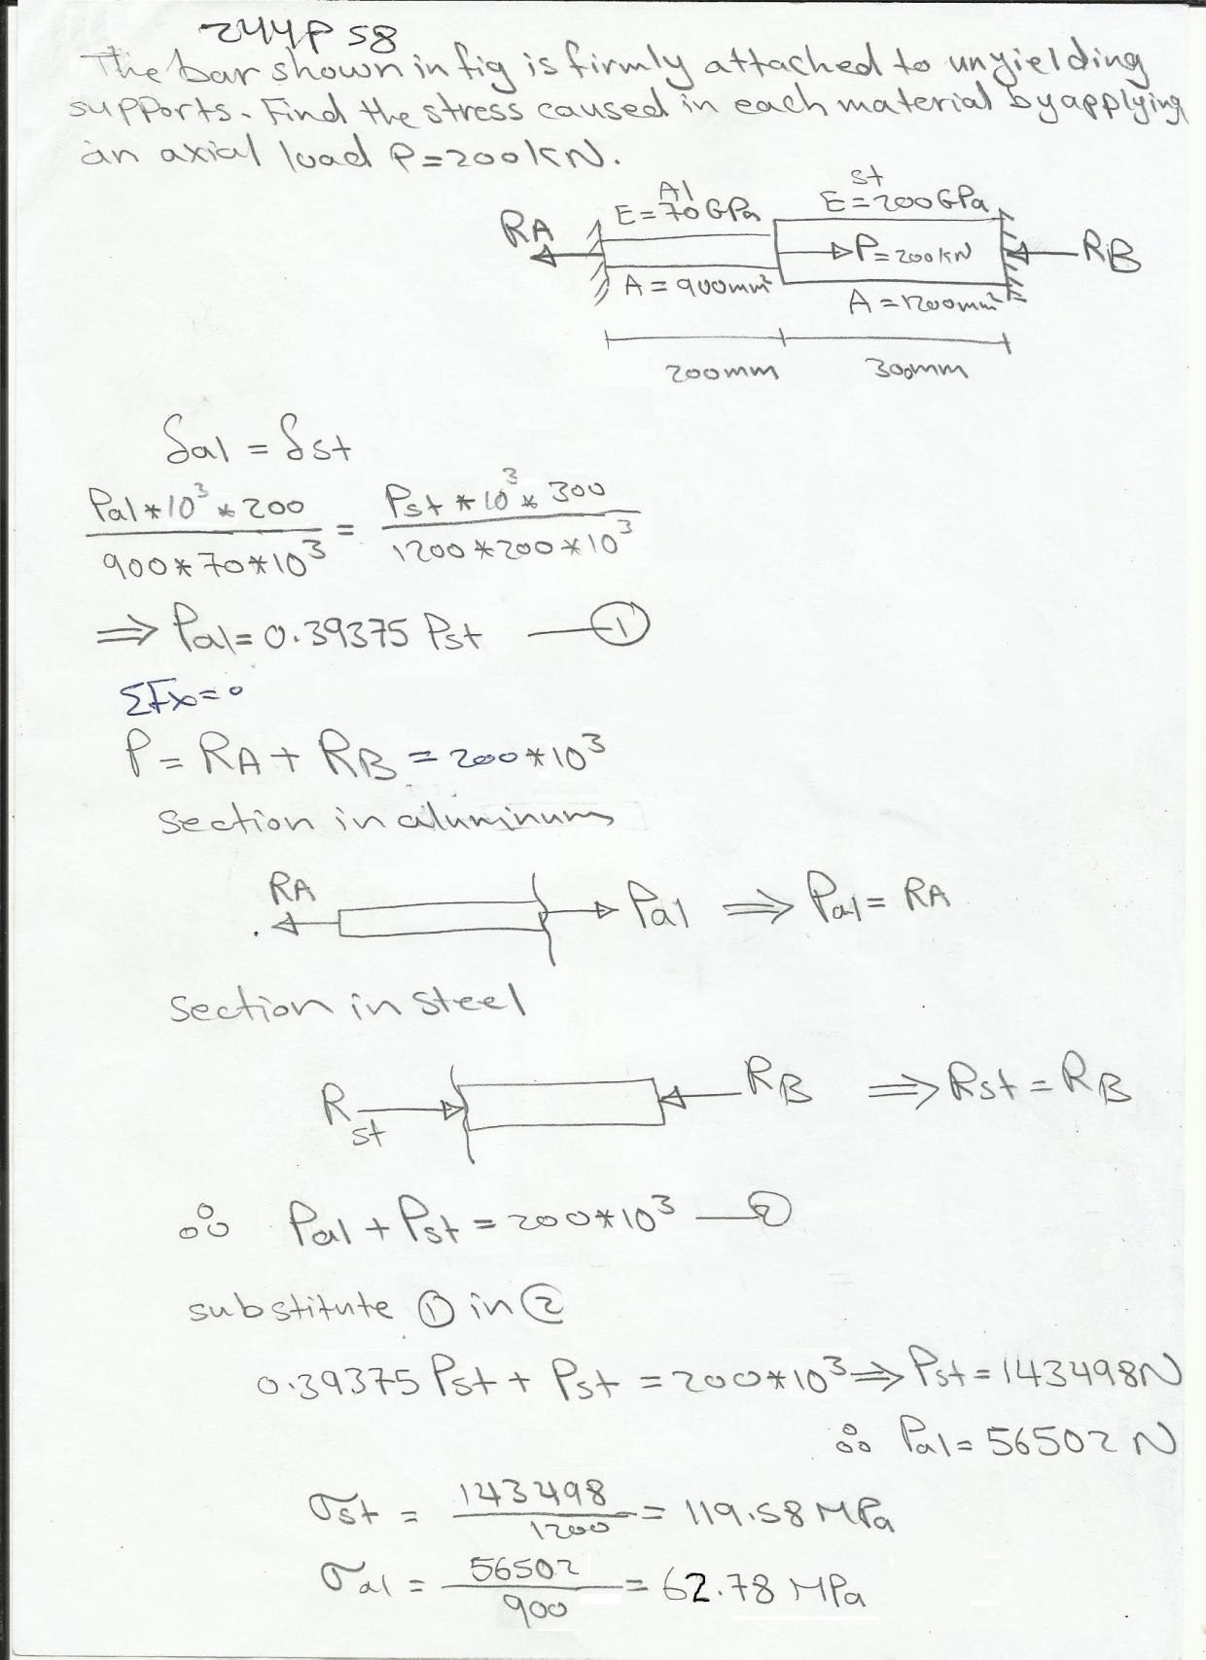

Slide 16
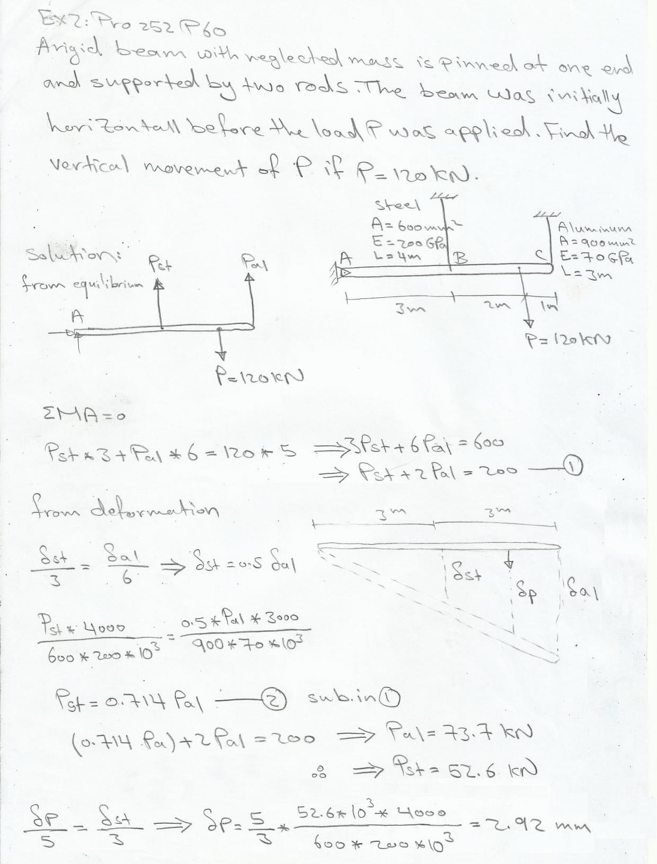

Slide 17
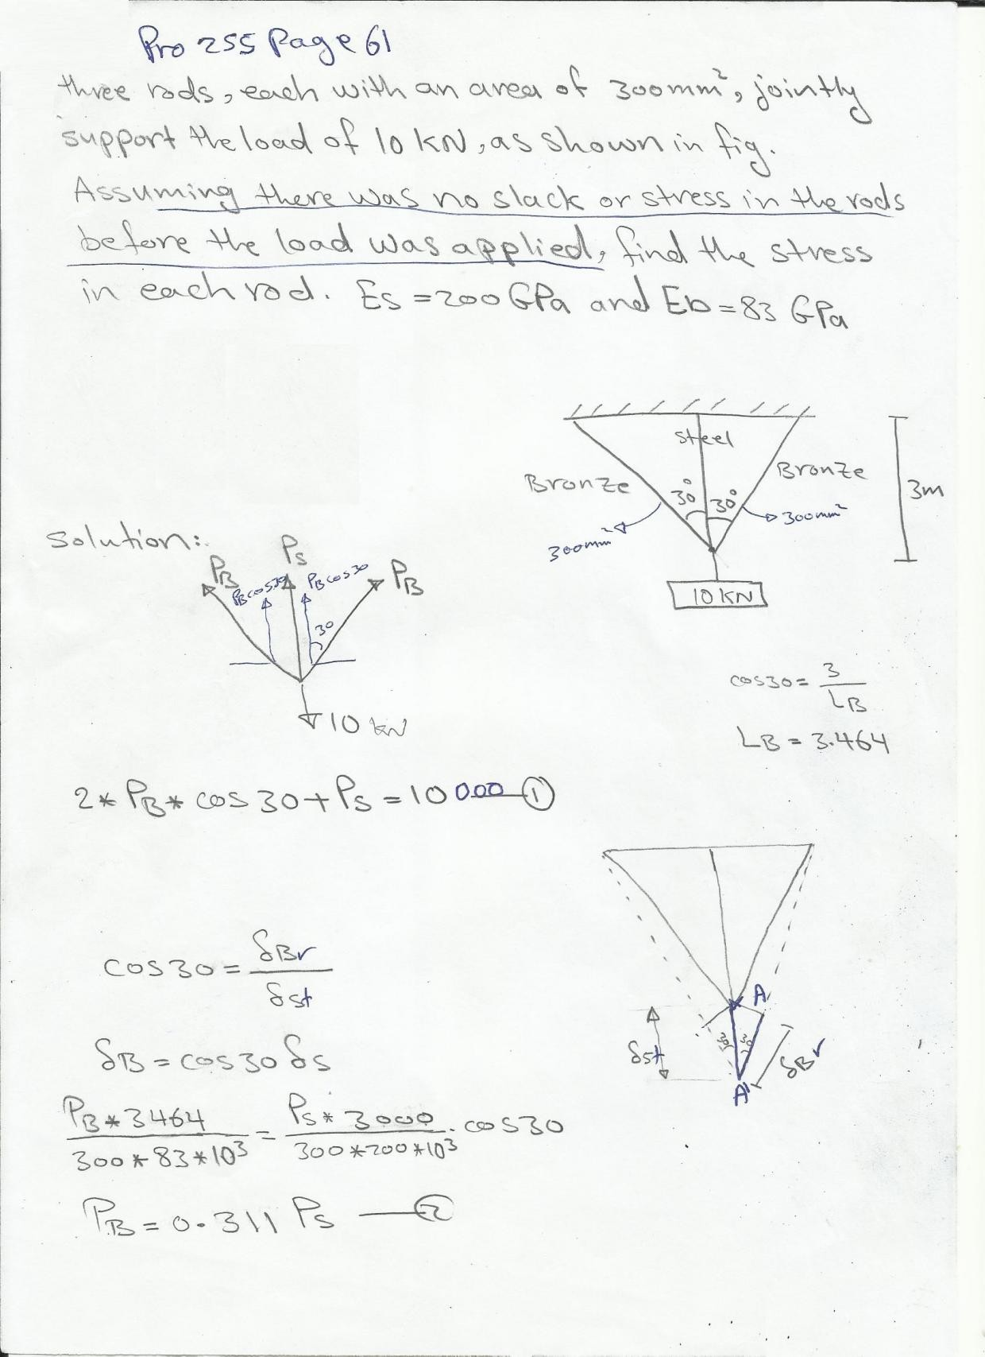

Slide 18
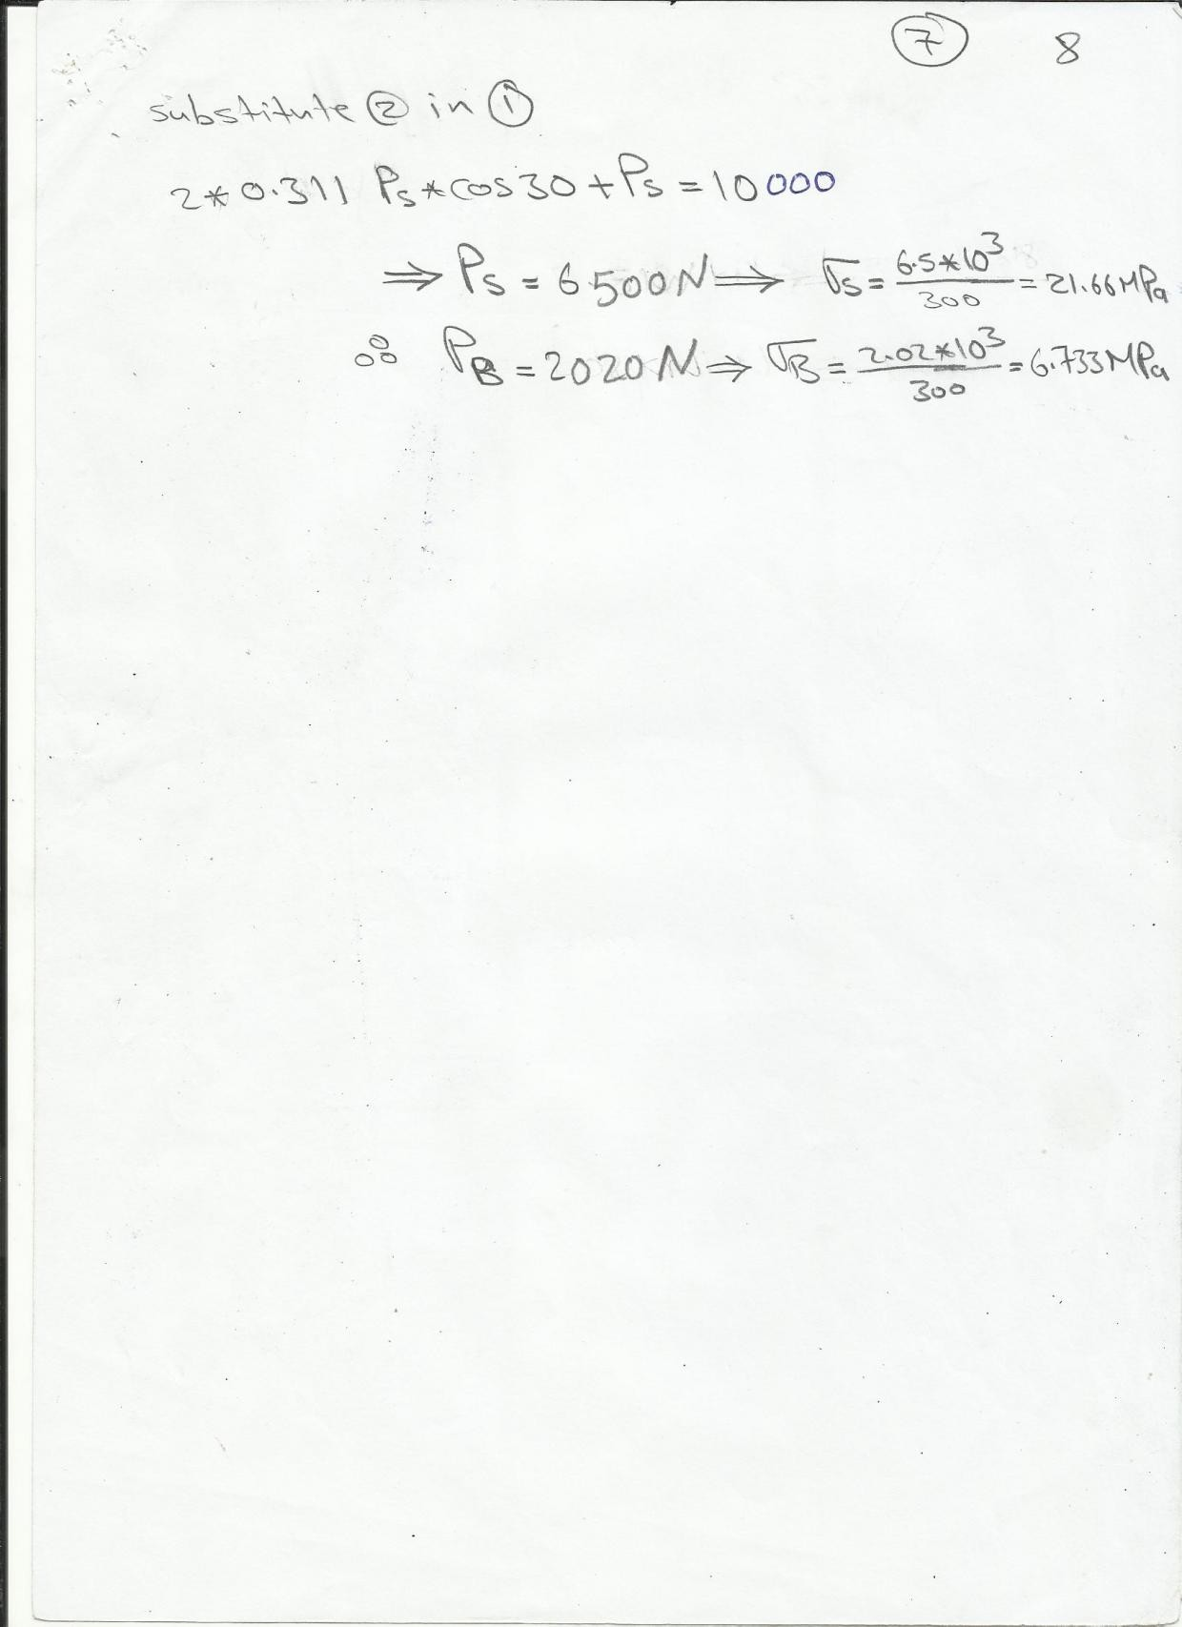

Slide 19
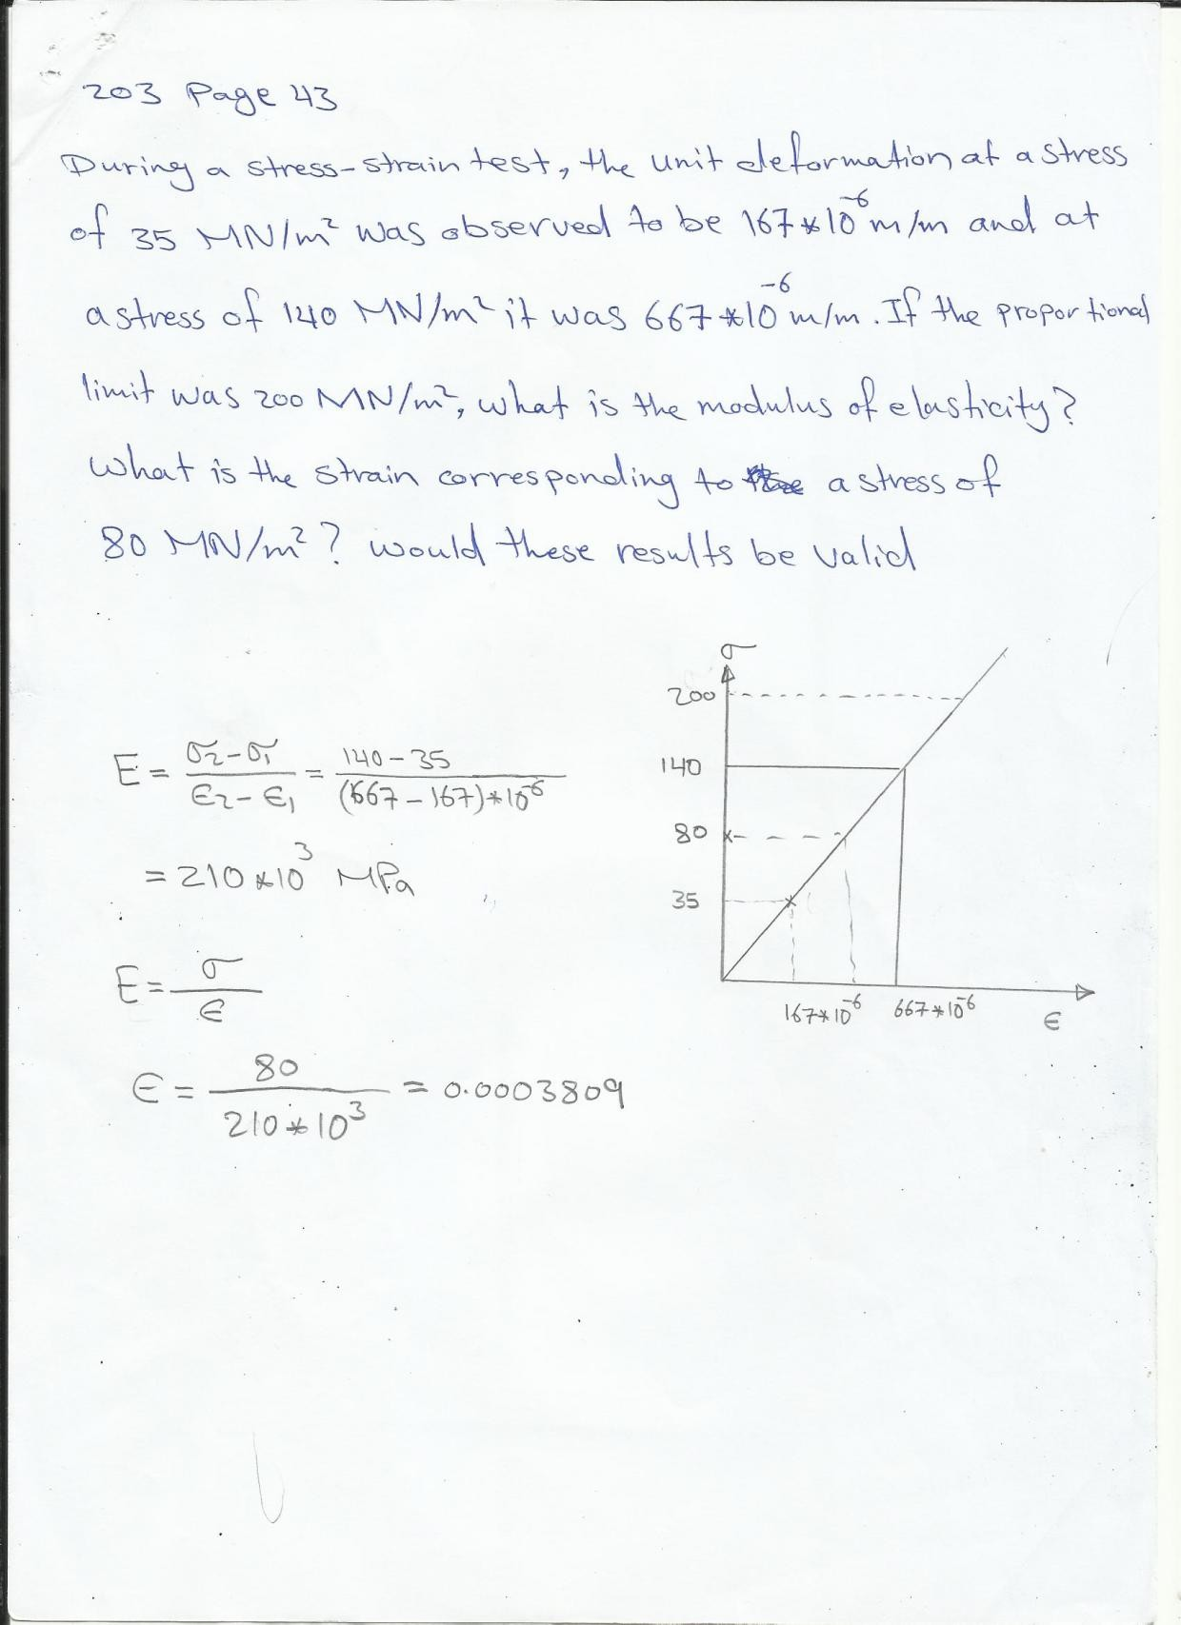

Slide 20
